Slide 1
Week12 presentation for Individual Project (After revising)
IET Yinghan Xu

Slide 2
Functionality
Don’t like too complicated images. Recall a memory of completely simple-image game.
Background, Player, Interaction=>All simple
Ninja (Designed like MatchStick Men)
Jump/Attack/Difficulty level (More time: barrier/dart/speed up)

Slide 3



Tools
Android Studio (Coding)
libGDX (Game Framework)
Github (Version Control)

Slide 4
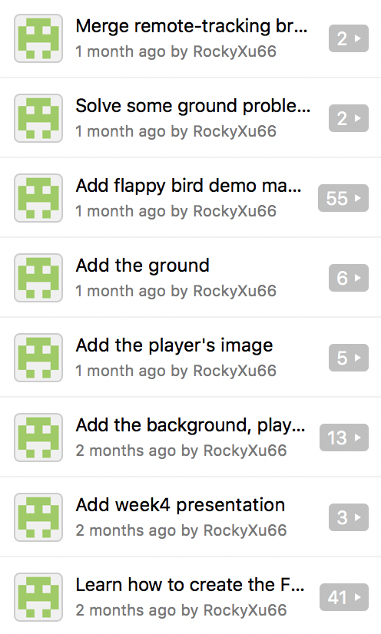
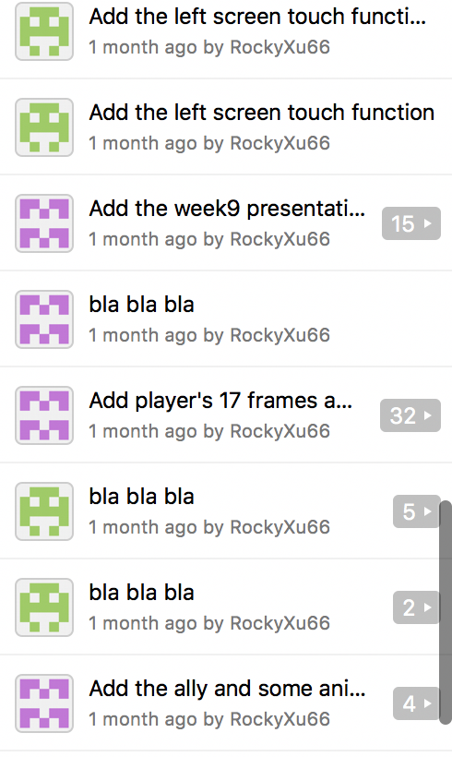
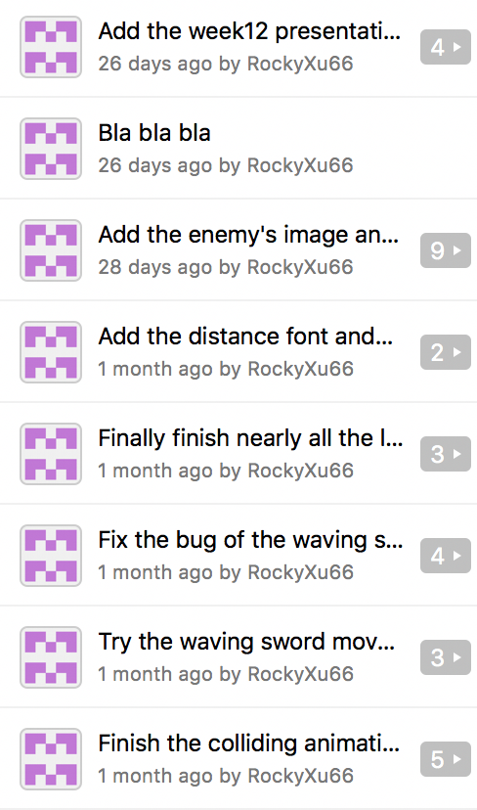
Github repository

Slide 5
From the repository, we can see there is 43 commits and 1 branch, which means I might commit once in two days and didn’t try to do any attempt for the new branch (another way to deal with the problem) I haven’t use github for a long time, so there’re some management problems. Maybe I should try some new branches to achieve different part of the task. Or maybe I should commit with some more valuable comments.

Slide 6
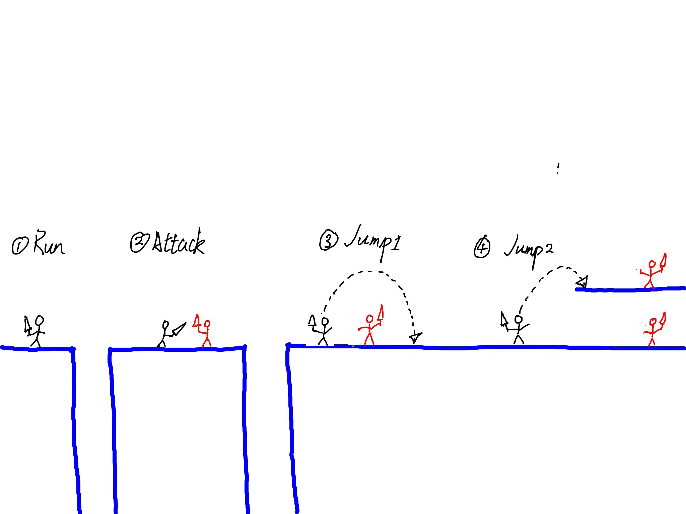
Planning result

Slide 7
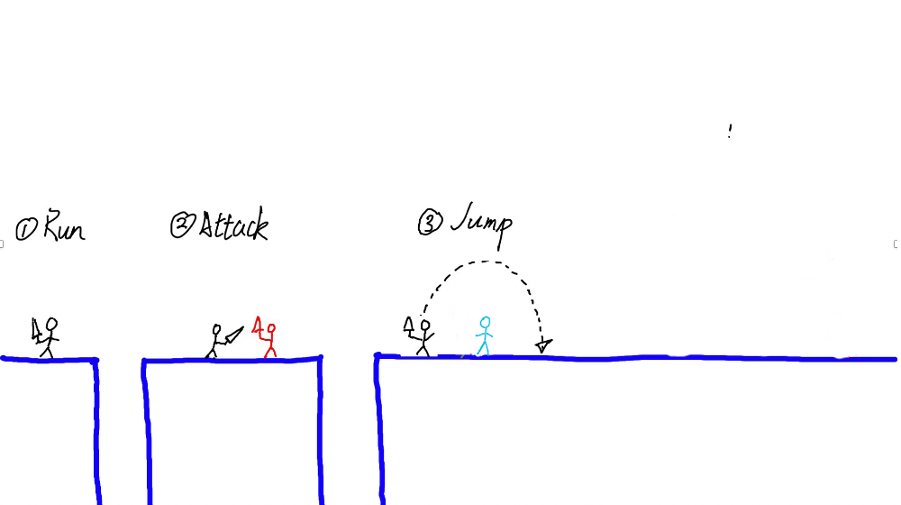
Final result

Slide 8
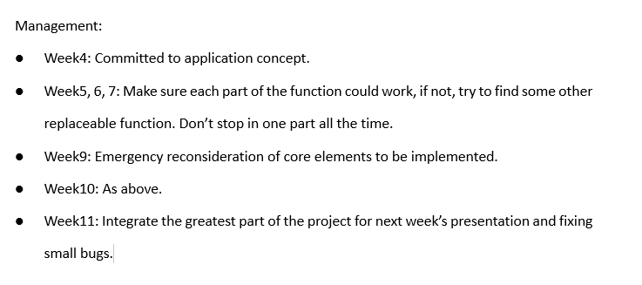
How to manage the progress

Slide 9
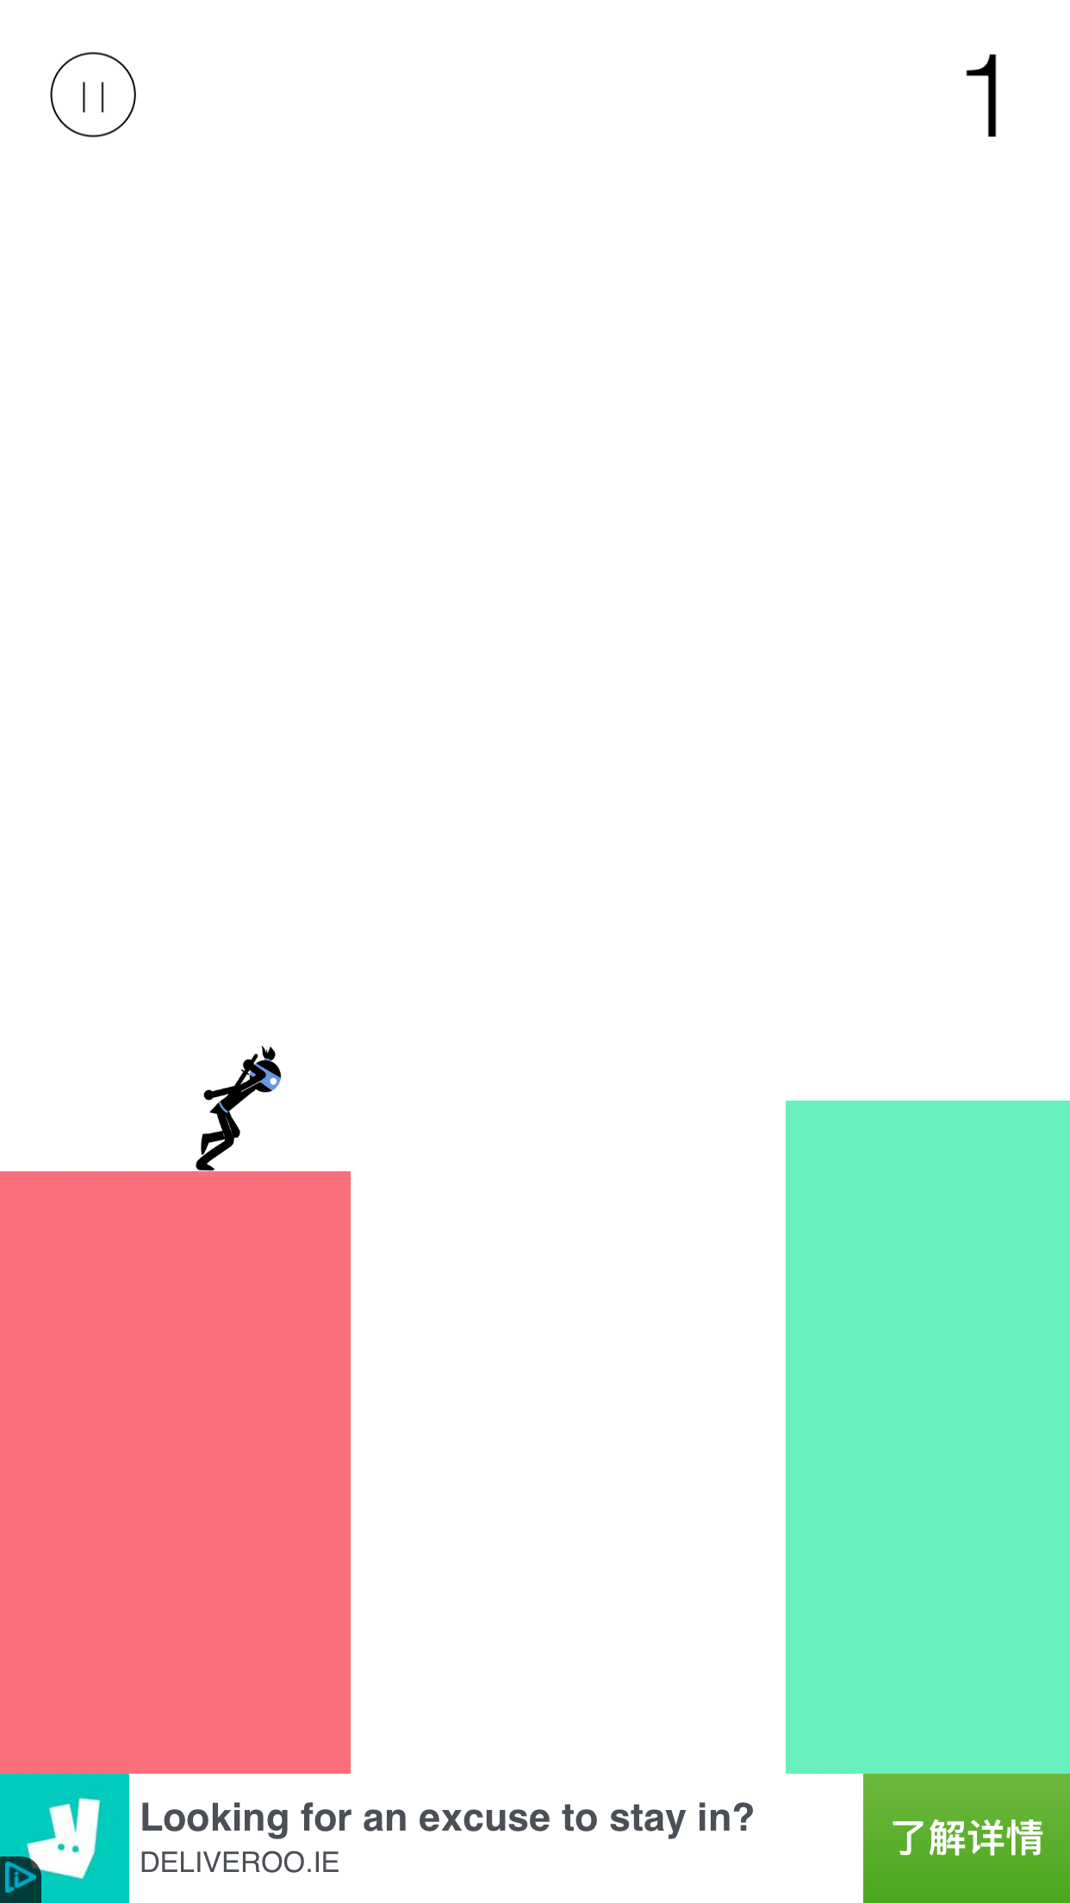
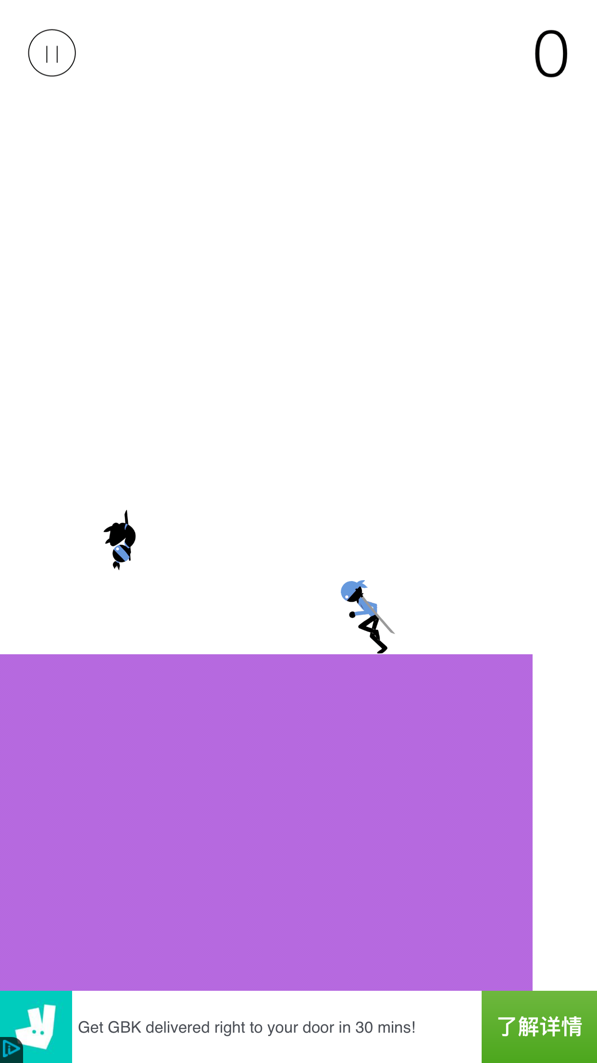
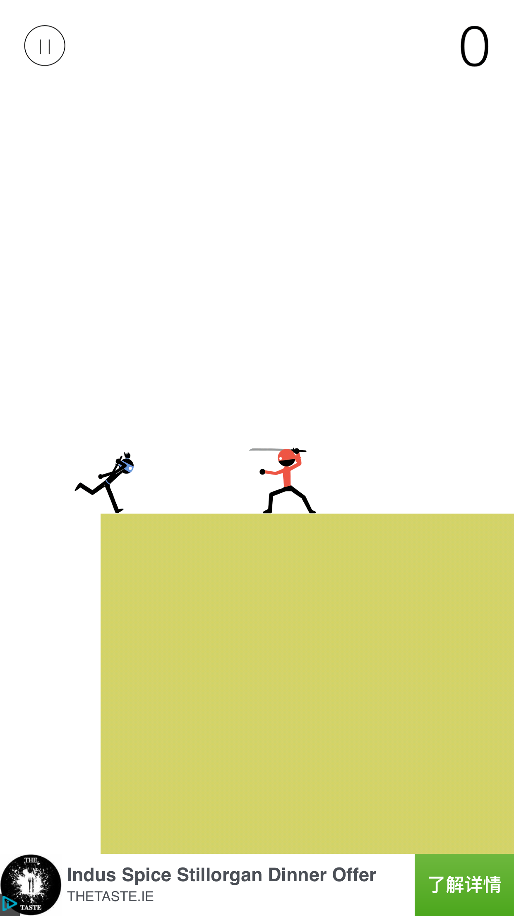
The game on the iphone

Slide 10
What I have done Demo (video)

Slide 11
Challenges
Know nothing about Android
Time is limited and many projects there

Slide 12
what I have learned and what I would do differently the next time.
How to manage the time (Might try to spend a long time focusing on solving the specific problem; Separate the whole project into different modules)
Problems I might face in a project (Time limitation, knowledge limitation, requirement changing) → how to solve them (Planning for a project, presentation, the whole requirement, the emergency solution prepared)

Slide 13
After looking at other people’s presentation, I find that in the first version of my week 12 presentation, there is no tools and techniques analysis. Also forget about talking the github management. These should be the basic content for the final presentation I guess.

